Slide 1
Sustainable Finance Hackathon
Presentation: Aditya Pandit & Jim Plant

Slide 2
Climate Extended RWA
Current
Basel III capital = CVA Capital + CCR capital + FRTB Capital (Market risk) + Operational Capital
Proposed
Basel III capital = CVA Capital + CCR capital + FRTB Capital (Market risk) + Operational Capital + Climate Risk capital

Slide 3
Idea
Create a small hypothetical loan book and identify green opportunities in that Loan book.
1. Use NLP to classify loans into the required EU taxonomy by using company reports and external data.
2. Understand and demonstrate how a bank may apply this regulation and identify loans that attract lower Climate RWA.

Slide 4
Goals
Reduce Lending Book capital for the bank
Inform Buy side / Investment companies investment decisions
Make funding available to companies that are transitioning and/or mitigating climate harm
Benefit the climate through better allocation of capital

Slide 5
Methodology
CERM Advanced model first - model the math in the paper and work backwards to ways to identify loans that attract lower capital
Methodology first - try to understand the intent behind the methodology - specifically section on Page 11 on reducing capital
Data first - try to see how existing data sources might be applied to the problem

Slide 6
Case Study
Real world industry sector with high environmental impact
Building industry - specifically manufacture of Cement
~ 4 % of Global CO2

Slide 7
Challenges
We do think that there is a need for a product which can look at portfolio of Assets and depending on this regulatory taxonomy measure the "greenness" of a portfolio, but there are challenges:
Measuring the relative physical and transition risk of companies within the same sector and region requires data.
Such data is scarce. Many of the metrics we’d like (e.g. Capex on mitigation projects) aren’t directly reported. Taxonomies are new.
Existing data is inconsistent. Even where some standardisation exists there are profound differences in interpretation.
Data is tied up in text. Where information IS available it’s in text form and its distributed across many documents and websites.

Slide 8
Detailed Methodology
To reduce capital under GreenRWA we need to measure Capex investment in Mitigation and Adaptation. To identify qualifying Capex within the Loan Book we:
1. Use NLP to identify the Taxonomy of each loan within the book*
2. For one Taxonomy (in our case Cement Manufacture)
1. Capture the Capex if it’s reported, otherwise...
2. Use NLP over various sources to identify qualifying projects (by materiality)
3. Use NLP over various sources to determine Capex expenditure
3. Identify some measure by which progress can be empirically tracked and progress demonstrated. In our case CO2 per Tonne of Cement.
*Using the EU TEG on Sustainable Finance taxonomy: https://ec.europa.eu/info/sites/info/files/business_economy_euro/banking_and_finance/documents/200309-sustainable-finance-teg-final-report-taxonomy_en.pdf

Slide 9
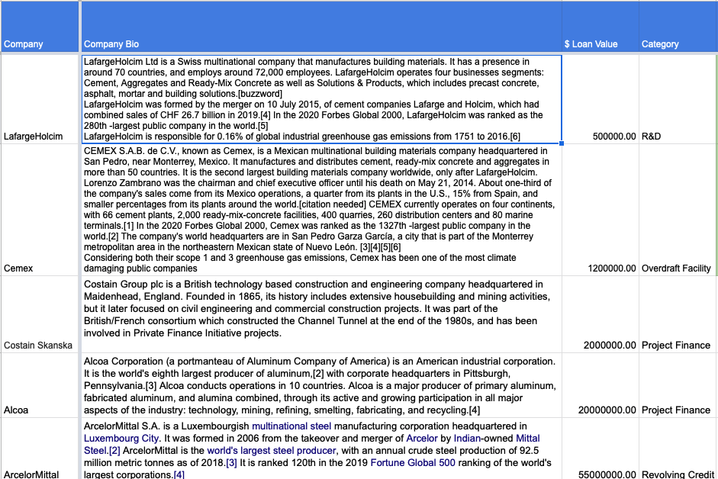
Our Loan Book

Slide 10
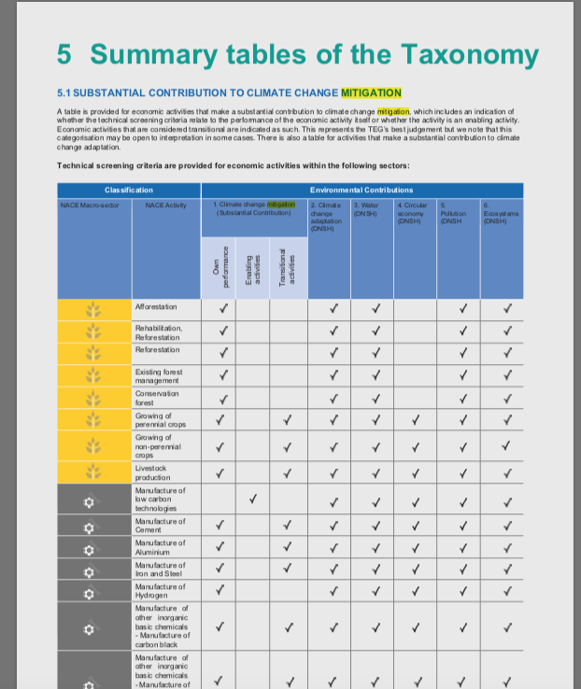
Taxonomy Identification
https://ec.europa.eu/info/sites/info/files/business_economy_euro/banking_and_finance/documents/200309-sustainable-finance-teg-final-report-taxonomy_en.pdf
Taxonomy doesn’t currently exist inside the bank

Slide 11
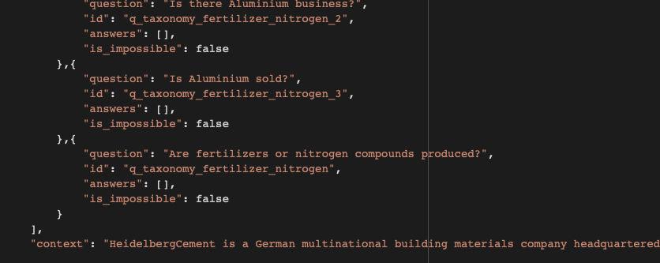
Taxonomy Identification - NLP
Use Electra NLP pretrained for Q&A https://arxiv.org/abs/2003.10555 (see also SQUAD benchmark: https://rajpurkar.github.io/SQuAD-explorer/explore/v2.0/dev/)
Colab Notebooks (Google hosted - free access TPU hardware)
We supply a panel of questions and use the company Bio as context

Slide 12
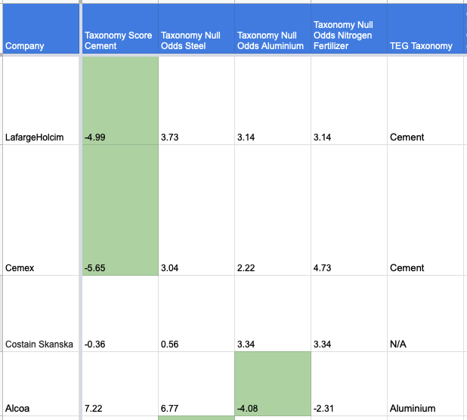
Taxonomy Identification - NLP
Model provides Null Odds scores which we can use to classify the loan book per EU taxonomies:

Slide 13
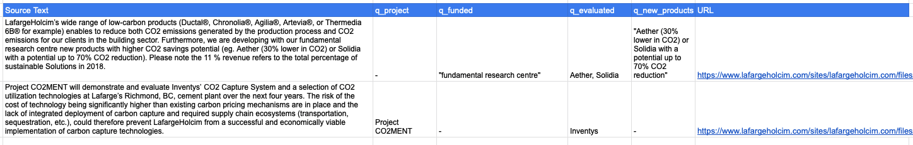
Project Identification
NLP Applied to Company Reports to pick up applicable projects

Slide 14
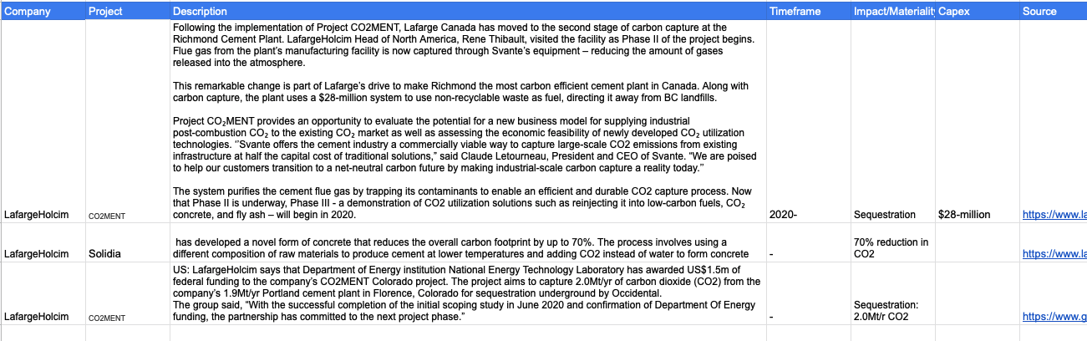
Project Capex and Materiality Assessment
NLP Applied to text describing the various projects that may qualify for Capex reduction

Slide 15
Summary
Banks that adopt Advanced Methodology and that can crack the challenges of data scarcity and consistency in this area have opportunity to price much more efficiently.
Obligors may have struggled to allocate capital to mitigation or adaptation projects because of the ‘far off’ nature of the risks. Advanced GreenRWA rewards such projects today with lower loan costs (via lower capital) creating a virtuous circle.
Even without sufficient metrics to accurately compute capital savings under GreenRWA this data is very useful in the credit decision making process in banks - e.g. using Co2 Per Tonne projections tells a lender which manufacturers are likely to be around in the medium and long term.

Slide 16
Summary
Data scarcity and consistency are significant challenges:
We developed a methodology and tech that may help here:
NLP extraction of facts from text in the form of company reports and news
Cross validation of the claims of companies and the wider internet
Next steps:
Combination of Q&A models with standard NER allow us to extract specific
metrics from the test

